Slide 1
B9.ba
HPC in Scripps Research - Garibaldi (high-performance computing)
Shang-Fu Chen
Handout https://github.com/ShaunFChen/2020_FA_HPC
Notes:
Hello everyone, Thank you for joining the lecture in this tough morning. I fully understand and encourage you to care about the election because it’s definitely related to everything in our life including researches, even for international students. Therefore, I decided that there’s not going to have Zoom polls, homework this class. This is a relatively advanced class, which combined and required all the skills you learn in this quarter and some biological background knowledge from genetics and genomics. Depend on your research, you might not even need to utilize HPC – not because of the scale – simply cuz your might have better choice or platform optimized already for your studies. So you don’t need to customize your own pipeline. Feel free to watch the course records later – it’s totally fine. Well… no one actually leave, I’m gonna cry.
Ok – as the last official lecture in this quarter, I’ll try to help you recap and wrap up the general workflow of pipeline development. While it’s very flexible to adjust according to your own studies.

Slide 2
Contents
Concepts of HPC
What
Why
When
Hands on practice on Garibaldi
Schedular commands (Torque/Maui)
Basic commands
Simple PBS script
Job script designing workflow
Basic Github
Case study
Overview
Ancestry inference using PCA
figure output (.png)
Ancestry inference with RFMix2
Fun results
Torque vs Slurm
Syntax comparison
Learning resources
Acknowledgement
Notes:
So here’s an overview of what we are going to walk through today.
Starting from a brief introduction and a quick hands-on practice – focusing on the current working environment in Scripps.
The case study part will be

Slide 3
Concepts of HPC

Slide 4
What is High-Performance Computing (HPC)?
https://hpc.rtu.lv/hpc/introduction-to-hpc/?lang=en
Notes:
High performance computing (HPC) allows solving complicated computing problems in a short period of time. Computing is carried out on high-performance computers (shared-memory mainframe, computing cluster) made up by many parallel processors
HPC cluster can be used for both parallel computing, providing parallel execution of a large job, and distributed computing, performing several independent tasks on separate servers or processors.

Slide 5
Why High-Performance Computing (HPC)?
Application can not be run on a conventional (serial) computing system
Insufficient memory
Insufficient computational power
HPC generally now means:
Large multi-processor system
Complex communications hardware
Specialized attached processors
GRID/Cloud computing

Slide 6
Hands on practice on Garibaldi

Slide 7
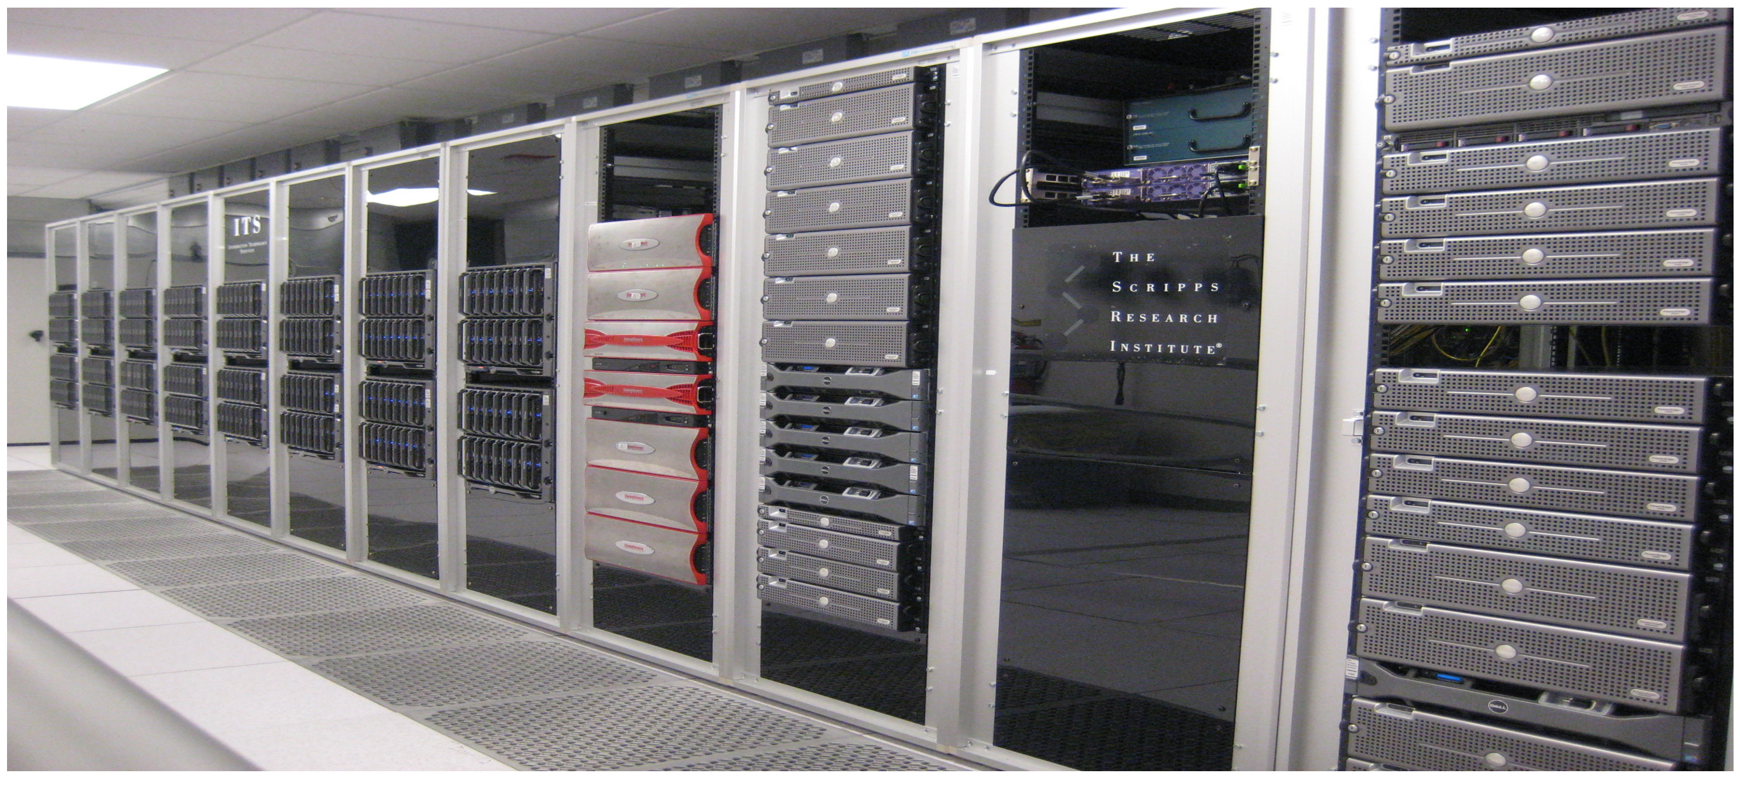
HPC in Scripps Research - Garibaldi
Notes:
Seeing is believing, this was what we had in the Scripps Research – and I thought it’s been moved to a room nearby the lobby in the immunology building – While I didn’t have access to enter the building during the pandemic last time when I tried to take a pic.

Slide 8
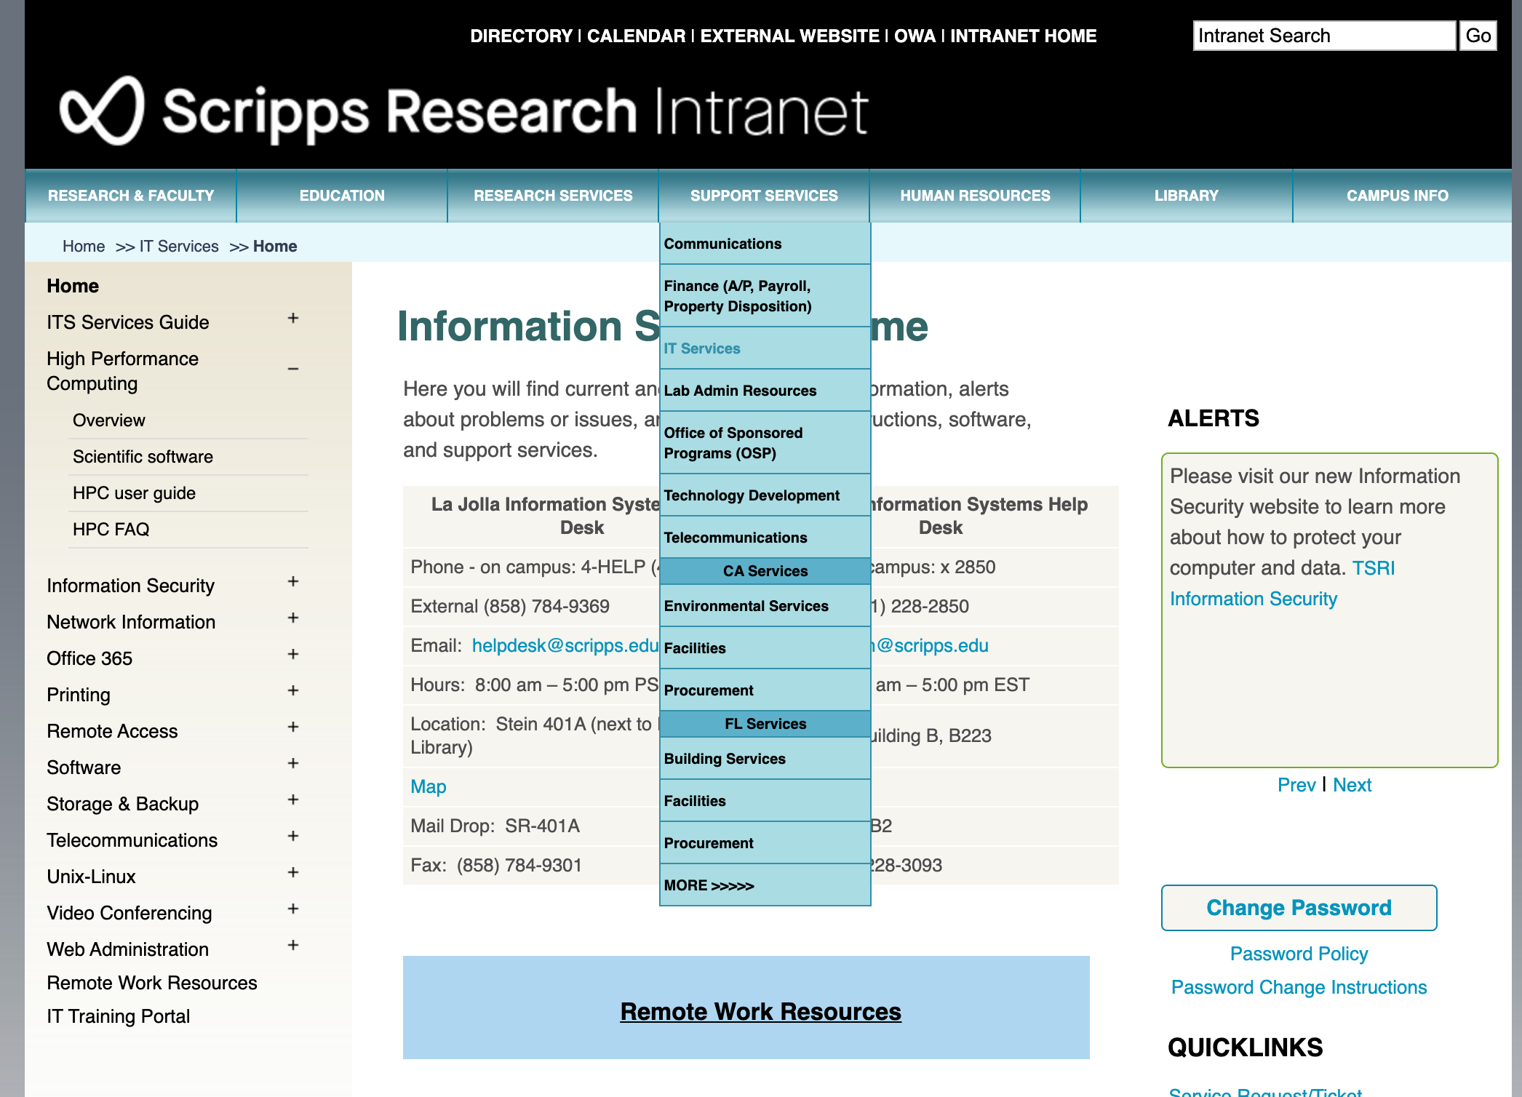
More Information in Scripps Intranet
1.
2.
3.
4.
Notes:
Most of the following information can all be found the intranet, after you login and found

Slide 9
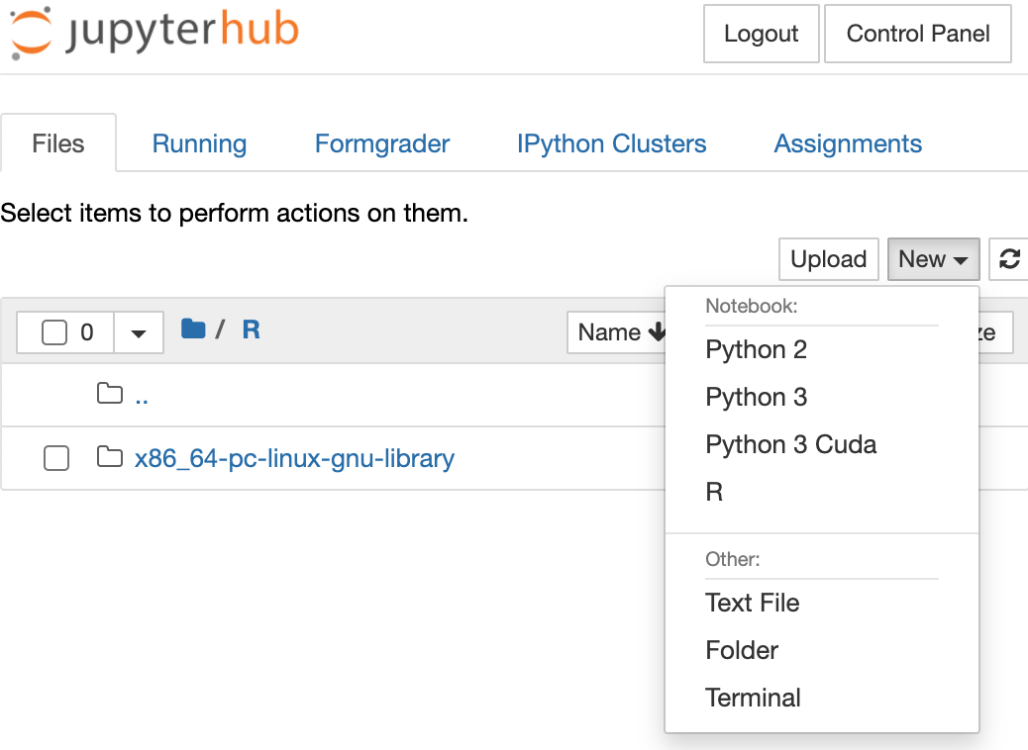
Login to head node
bash-4.1$ ssh instructor-abcb2020@login00.scripps.edu
The authenticity of host 'login00.scripps.edu (172.29.83.22)' can't be established.
RSA key fingerprint is 93:6c:ae:7a:7a:00:00:00:00:f9:f3:00:00:00:a9:00.
Are you sure you want to continue connecting (yes/no)? Yes
instructor-abcb2020@login00.scripps.edu's password: 🔒
Permission denied, please try again.
instructor-abcb2020@login00.scripps.edu's password: 🔒
Last login: Fri Oct 23 01:56:11 2020 from vpn-240-175.scripps.edu
*************************************************
* *
* Please contact hpc_ca@scripps.edu *
* *
* if you experience any problems with Garibaldi *
* *
* ( applications, slowness, scheduling, etc...) *
* *
*************************************************
[instructor-abcb2020@login00-adm instructor-abcb2020]$
Notes:
Ok, first step, how do we
Finish until everyone follow up

Slide 10
Work remotely… Say bye to GUI!!!
scp
git
# upload single file to remote server
Local $ scp foo.txt user@login00.scripps.edu:~/
# download wildcard/folder from remote server
Local $ scp –r `user@login00.scripps.edu:~/bar/*` ./
# create a new repo
Local $ git init # follow the instructions
# add commit when own code changed
Local $ git add .
# record own commit message
Local $ git commit –m “message”
# push the own code change
Local $ git push
# load git module
Remote $ module load git-lfs
# clone the repo
Remote $ git clone https://...git
# pull change when own code updated
Remote $ git pull
https://hpc.rtu.lv/hpc/introduction-to-hpc/?lang=en
Notes:
High performance computing (HPC) allows solving complicated computing problems in a short period of time. Computing is carried out on high-performance computers (shared-memory mainframe, computing cluster) made up by many parallel processors. A modern HPC is an essential element of any contemporary university, and it is used for various purposes ranging from solving engineering problems in MATLAB environment to big data analysis and machine learning.
The majority of HPC systems, including the one available at RTU, are designed as computing clusters, which consist of numerous separate servers interconnected by fast computer network (e.g., InfiniBand). HPC cluster can be used for both parallel computing, providing parallel execution of a large job, and distributed computing, performing several independent tasks on separate servers or processors. In addition, RTU HPC cluster is equipped with powerful NVidia Tesla GPU accelerators.

Slide 11
Basic commands & variables
usage
qstat –u [username] –f [job_id]
qsub –I
-l (mem/nodes/walltime)
-M (mail address)
-m (mailing condition)
-N (job name)
-v (variable)
qdel [job_id]
module
module load
module unload
module purge
module av
$PBS_O_WORKDIR
Notes:
If you did this, fine – just don’t tell people that you learn HPC from me.
htop in login node

Slide 12
usage
[sfchen@login01-adm sfchen]$ usage
host user job_name ncpu job_id walltime
----------------------------------------------------------------------------
nodeb0201 sfchen 6_ukb_hap_v2_024 16 993629.garibaldi 11:27
nodeb1228 sfchen 6_ukb_hap_v2_023 16 993154.garibaldi 27:32
nodeb1230 sfchen 6_ukb_hap_v2_022 16 974631.garibaldi 47:14
nodeb1231 sfchen 5_ukb_hap_v2_026 16 995463.garibaldi 43:00
----------------------------------------------------------------------------
Running: 140 jobs 1892 cpus
user jobs cpus
--------------------------------------------------
sfchen 4 64
--------------------------------------------------
Total Running 4 64
Queued: 10973 jobs 51830 cpus
user jobs cpus
--------------------------------------------------
sfchen 24 24
--------------------------------------------------
Total Queued 24 24

Slide 13
Simple PBS script template
#!/bin/bash
#PBS -l mem=4gb
#PBS -l nodes=1:ppn=1
#PBS -l walltime=12:00:00
#PBS -M [username]@scripps.edu
#PBS -m a
#PBS –N job_name # (useful when jobs are listed)
# qsub –v month=,day= test.pbs
module load R
cd $PBS_O_WORKDIR # (instead of cd /gpfs/home/user_id)
echo “Hello HPC!! Today is ${month} ${day}”
Notes:
processes per node
What if you want to run R or Python code in the job script?

Slide 14
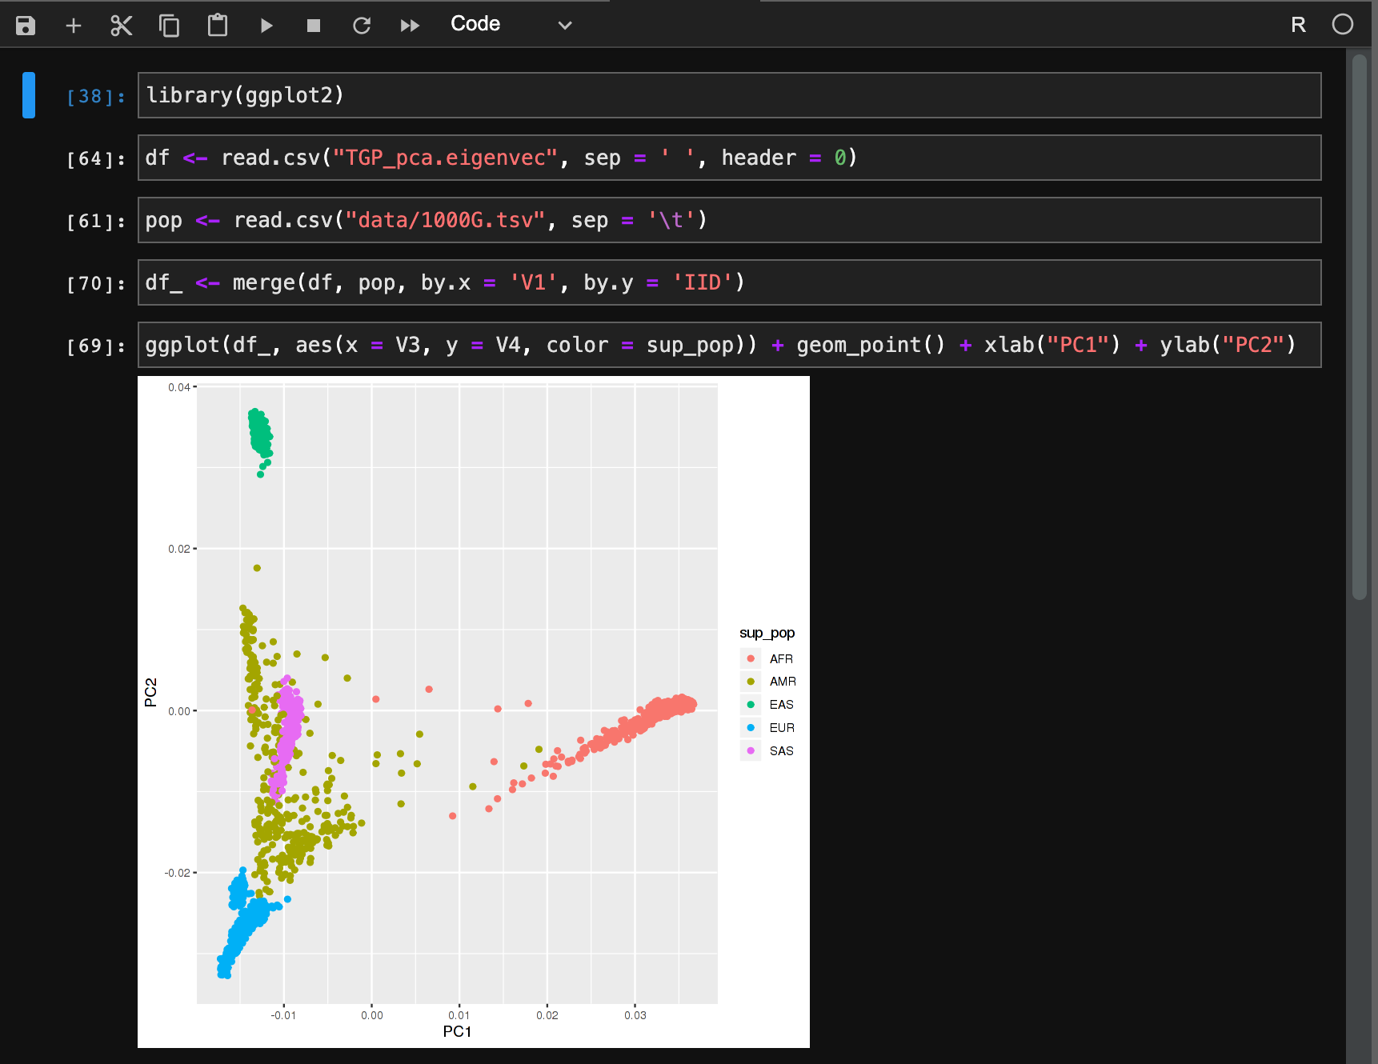
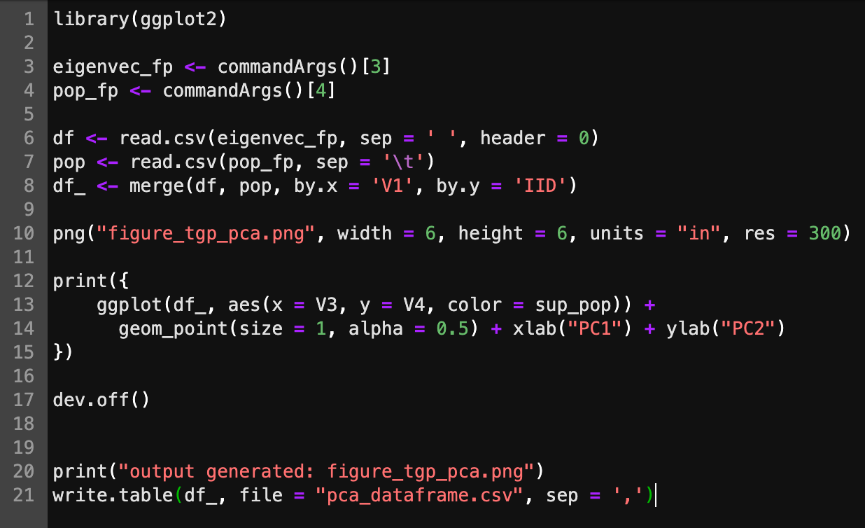
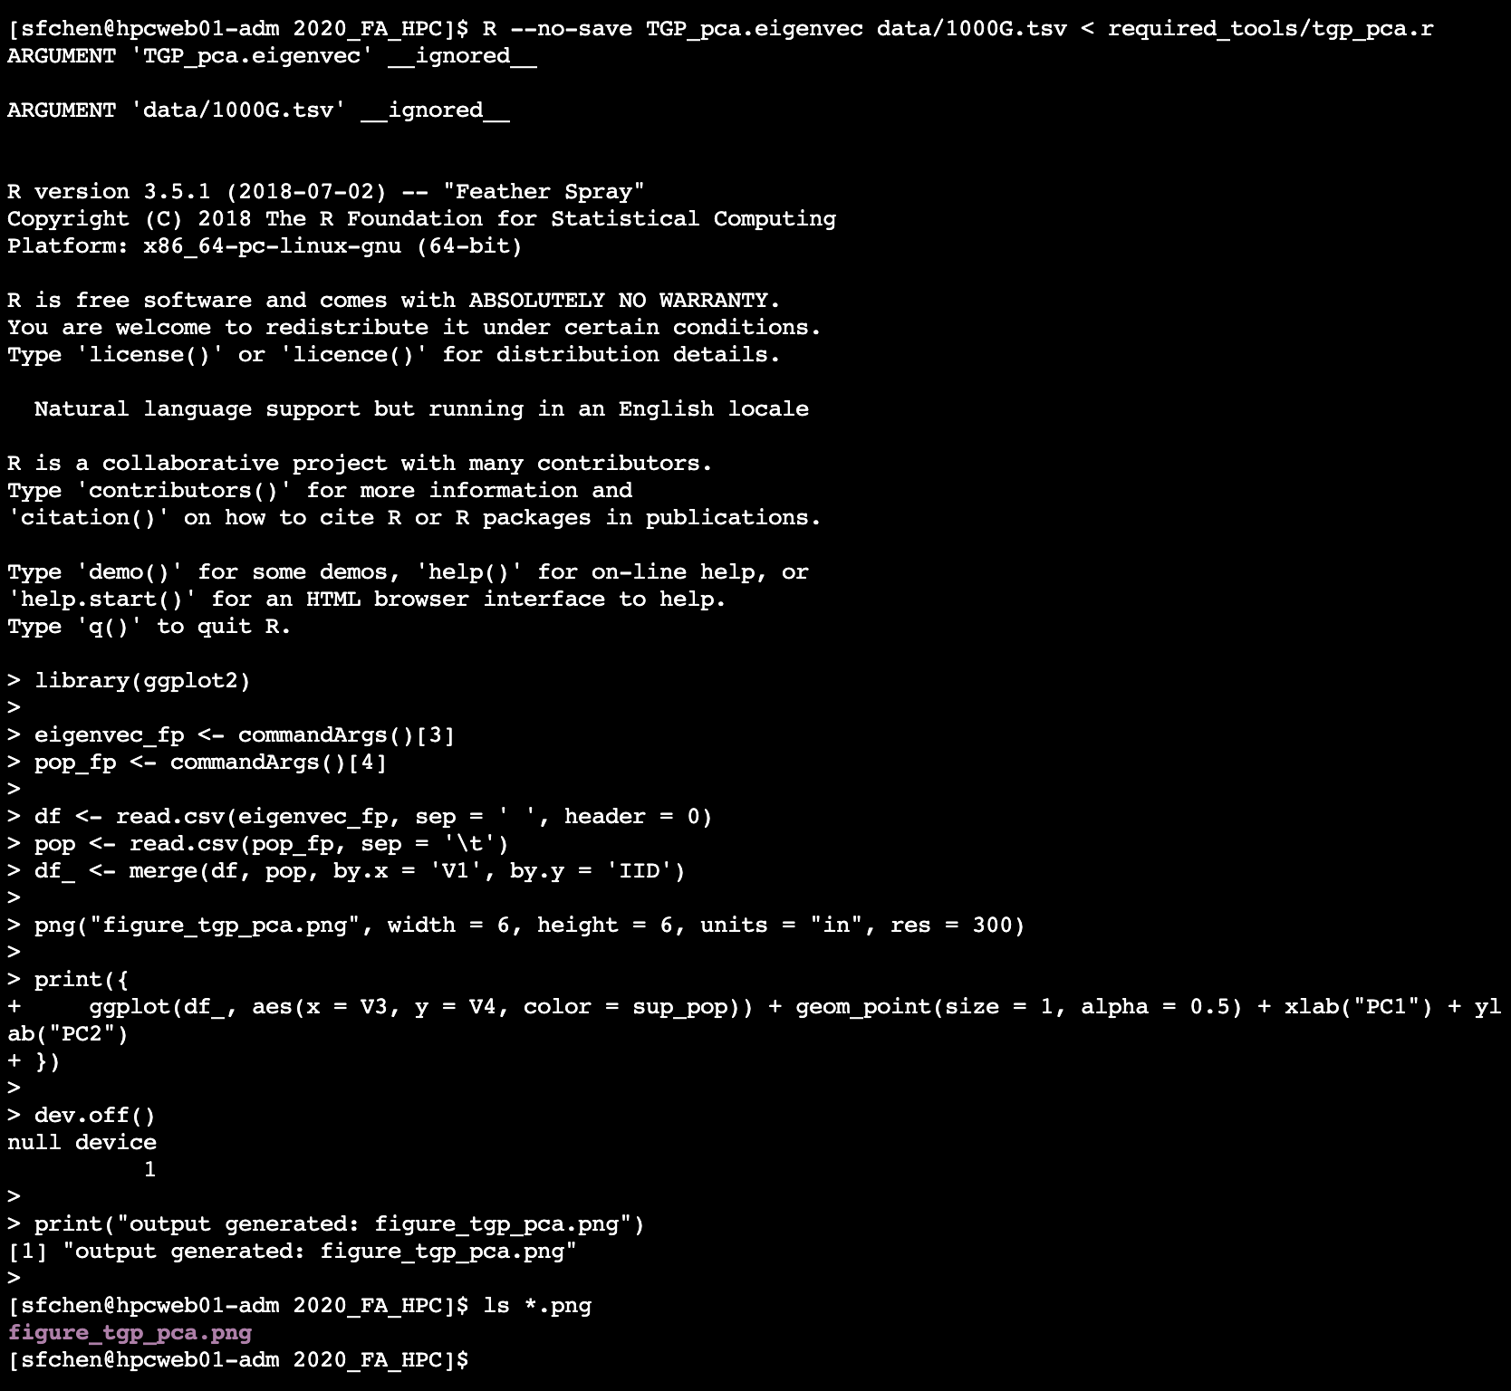
Jupyter notebook vs executable script

Slide 15
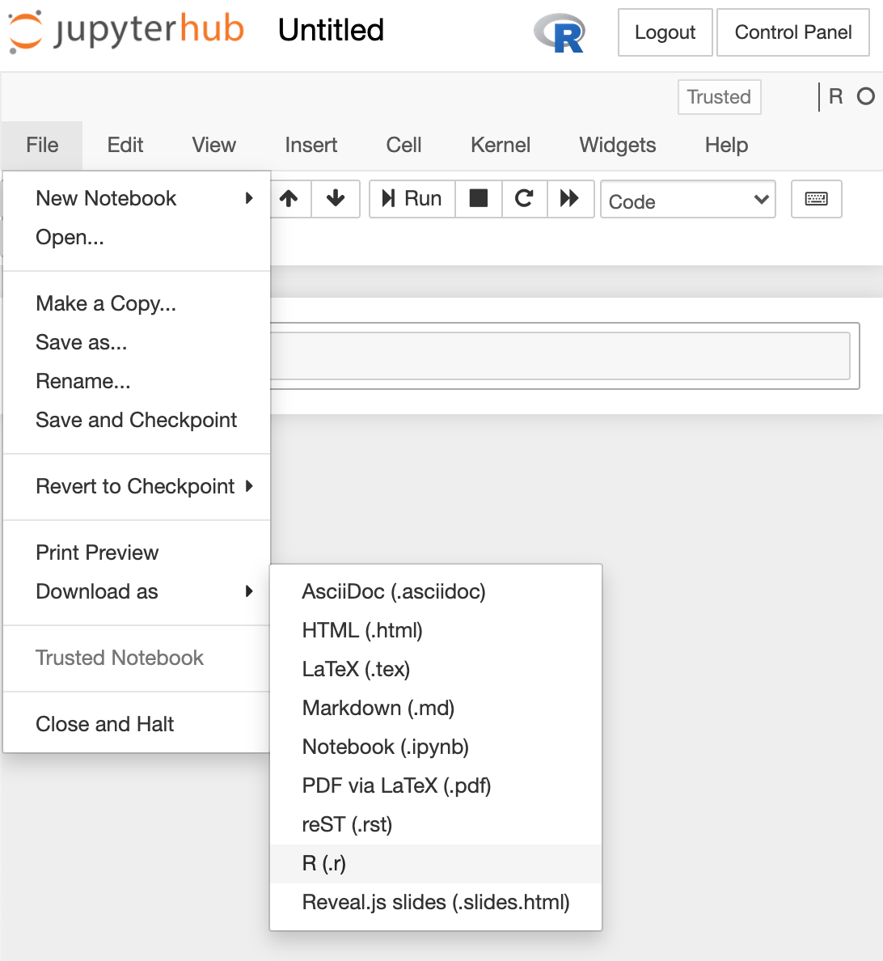
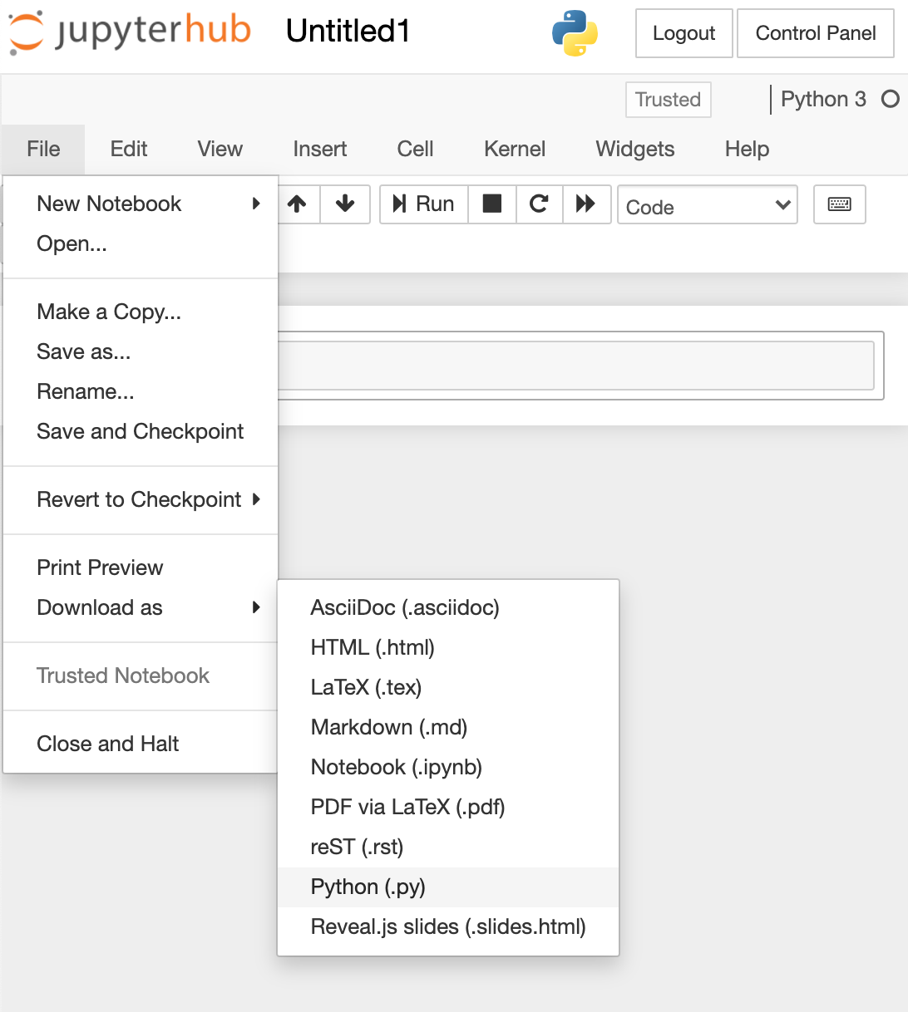
Export notebook to executable script

Slide 16
More jobs ≠ faster
Allocate the proper resource
Optimize your code
Be patient…
HPC Challenges — A Perspective for General Data Analysis and Visualization
http://web.eecs.utk.edu/~huangj/hpc/hpc_intro.php
Notes:
Say you split your simple for-loop to 1000 pieces of jobs, each of the jobs only take 5 sec. Would it finished altogether within 5 sec? No, cuz you spent too much time waiting the work sehcdular distributed your jobs , communication and sync the input and output.
Therefore, the granularity should be balanced when you design the job size.

Slide 17
Take Home Message - Caution
Caution
Never compute at login node
Never use root permission (no sudo)
Max job number
started from 10
Put `sleep 3` between loop of job submission
Do
Backup your projects frequently
Respect other users (shared space and privacy)
Be responsible/responsive for your behavior
Inform your PI for data management
Be friendly with hpc_ca@scripps.edu

Slide 18
Take Home Message – Pipeline Development
First draft
Interactive debugging (Local Jupyter)
Shut down the session when leaving…
Test case
Form executable script
Unit test
If you in [“standardize multiple steps processing”,
“job couldn’t finish within feasible time”,
“local machine overheated”,
“wanna go home earlier”]:
Build pipeline
Print (echo) checkpoint message; Save human readable logging output
Allocate proper resource
Merge or split jobs for optimized granularity
Remove temp files when jobs finished
Fully understand the working concept of the tools
Do not treat the tools as black boxes
Read background article or even source code if needed
Speed: C/Java > JS/Python/Perl > R
Notes:
Plan ahead!! (Make flowchart on your whiteboard):

Slide 19
Resources
2020_FA_HPC https://github.com/ShaunFChen/2020_FA_HPC
Scripps Intranet
https://intranet.scripps.edu/its/highperformancecomputing/index.html
Scripps Libraries
https://www.scripps.edu/science-and-medicine/cores-and-services/library/index.html
pbs2slurm https://github.com/bjpop/pbs2slurm
GNU Parallel and Multiprocessing
https://github.com/ShaunFChen/CBB_Parallel_Multiprocessing

Slide 20
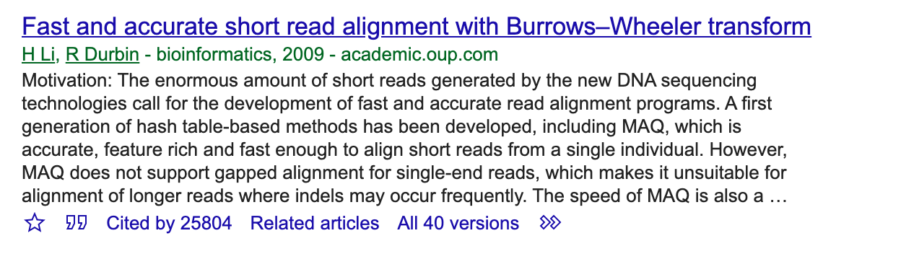
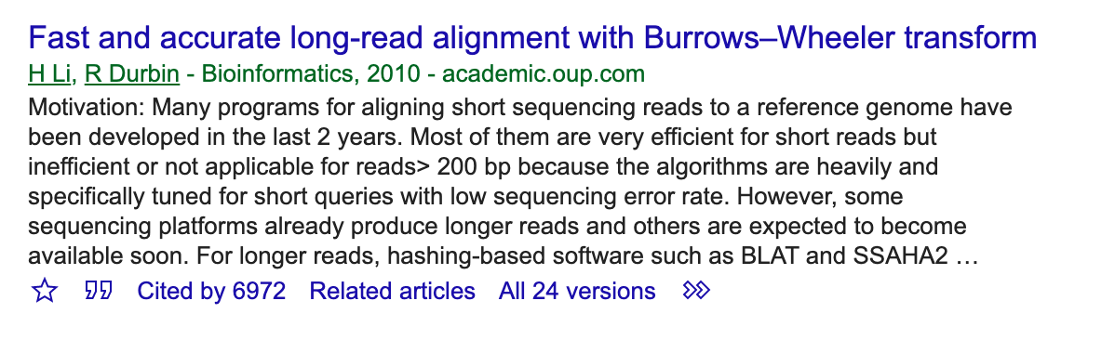
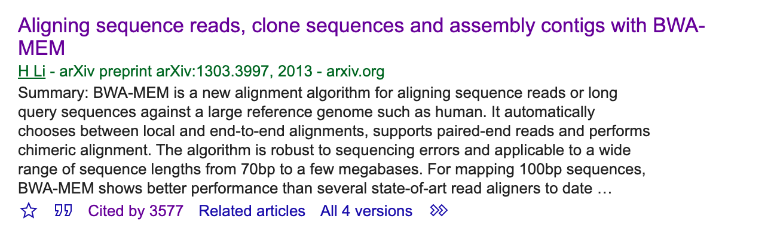
Be aware of the limitation of your tools.
Medium | @chungtsai
Li, Heng. "Exploring single-sample SNP and INDEL calling with whole-genome de novo assembly." Bioinformatics 28.14 (2012): 1838-1844.

Slide 21
Grill your skewers pipeline!!
You
Customized
Pre-QC
(python/R)
Container
(consistent
environment)
Shell tools
(bash)
Customized
Post-QC
(python/R)
Job script
Make plot
(python/R)
https://mypureplants.com/grilled-vegetable-kabobs
Notes:
Multiple process - cooking parallel

Slide 22


O’Reilly Online Learning Platform - II

Slide 23
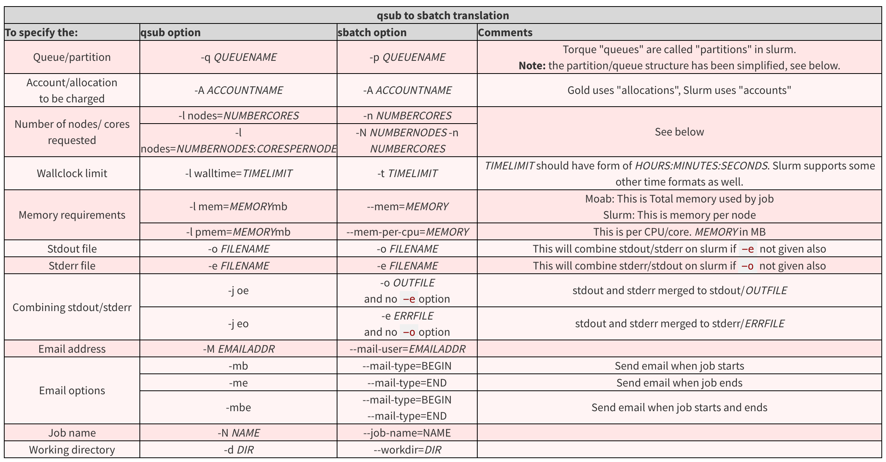
Slurm vs Torque (UMD)
https://hpcc.umd.edu/hpcc/help/slurm-vs-moab.html

Slide 24
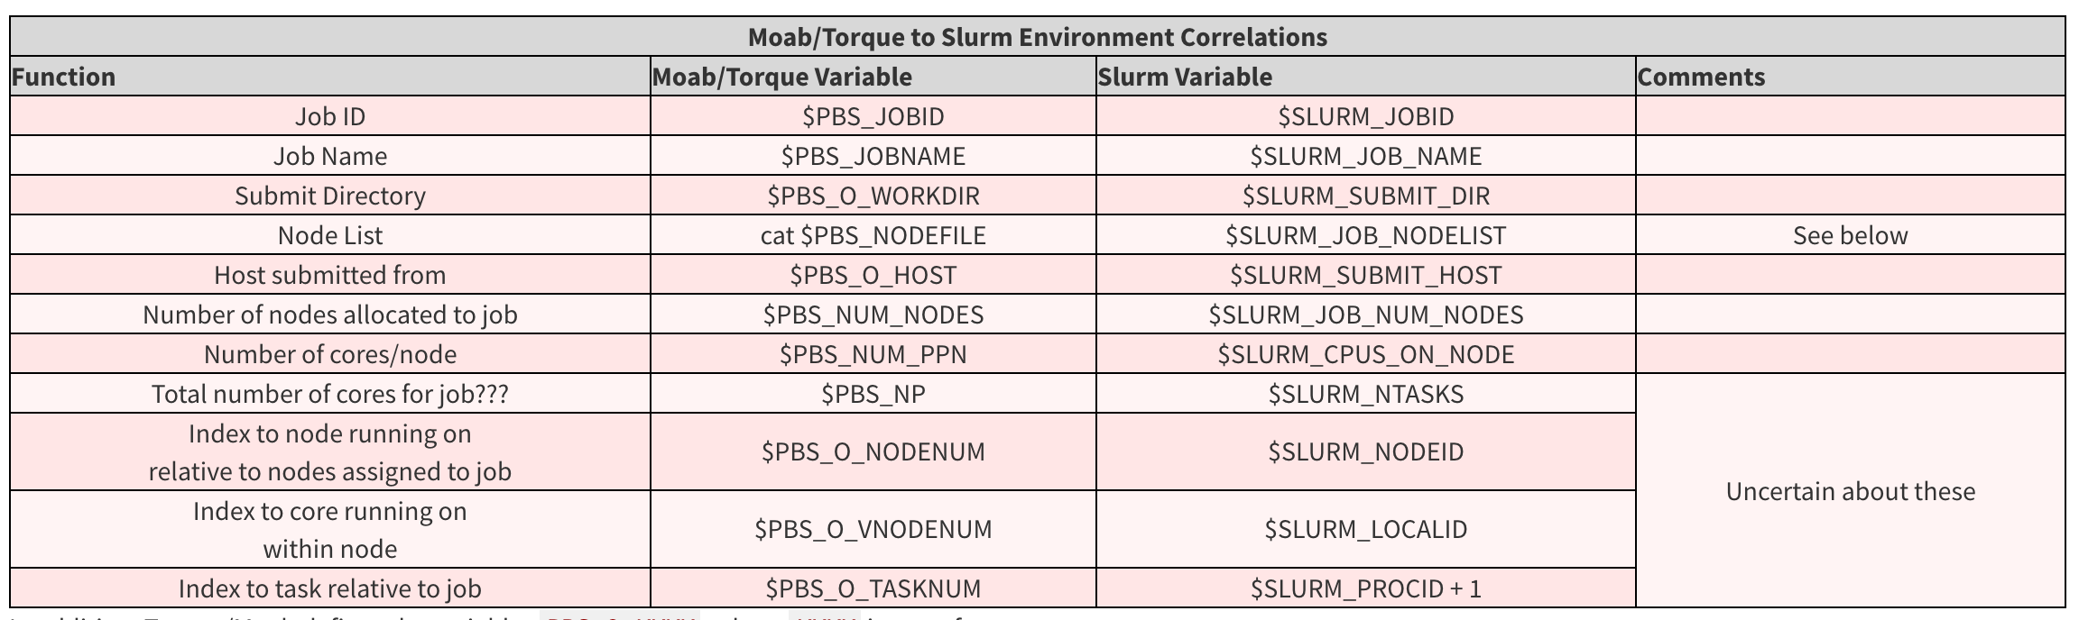
Slurm vs Torque (UMD)
https://hpcc.umd.edu/hpcc/help/slurm-vs-moab.html

Slide 25

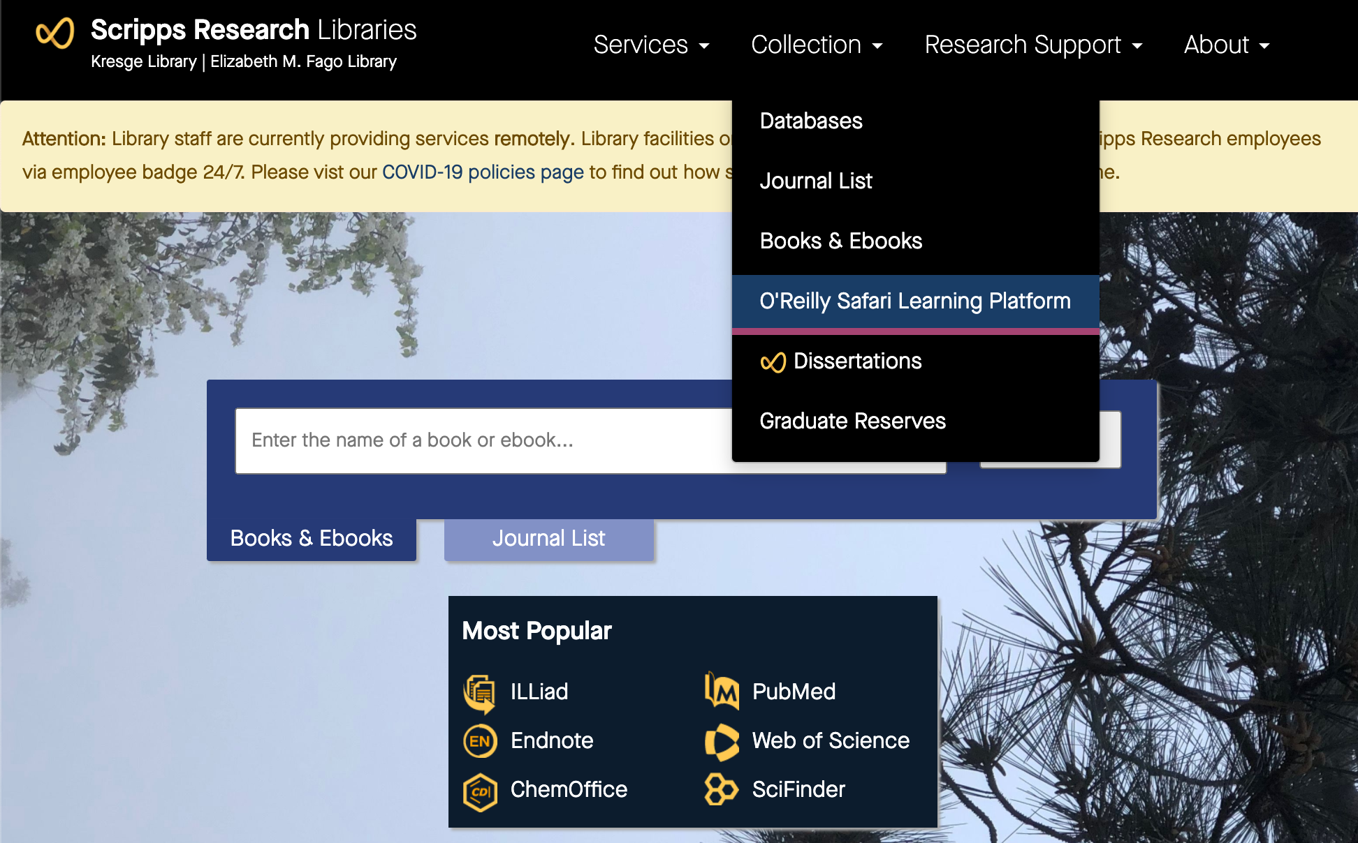
O’Reilly Online Learning Platform - I
2.
3.
1.
Scripps Research Libraries https://www.scripps.edu/science-and-medicine/cores-and-services/library/index.html

Slide 26
Thanks for your attention!! Wish you have…
Shang-Fu Chen

